Slide 1
Introduction of Basic Convolutional LSTM Model to predict Particlulate Matter
Presented by lee seonggu
Sungkyunkwan University (SKKU), Korea
Notes:
I’m planned to explain my prediction model more detail.
So In this presentation,
I’ll focus on how my Convolutional LSTM Model process data and predict particlulate Matter.

Slide 2
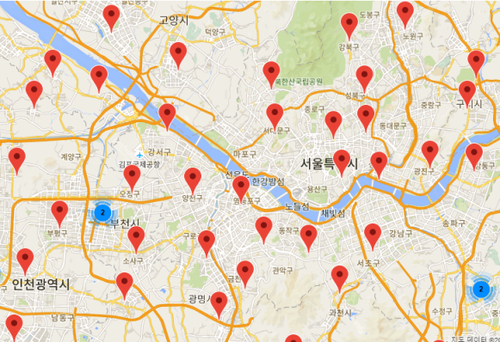
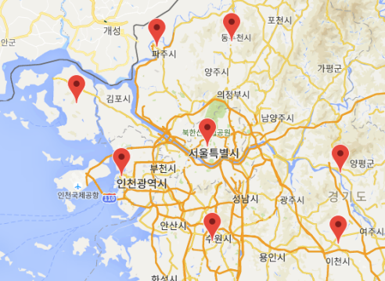
Input Data Format
data format = (row x column x feature x input-timestep)
Row and column denote to relative location of stations.
2. Feature denotes to particulate matter concentration and methodological data.
….
feature
mapping
row
Input timestep
column
3D tensors (4D)
Notes:
Before we start, I’ll show you an input data format to let you know all process more clearly.
Data has 4 dimension containing row, column, feature, input-timestep.
Row and column denote to relative location of stations.
Feature denotes to particulate matter concentration and methodological data.
input-timestep will be explained on next slide

Slide 3
Encoder-Decoder Structure
Encoder-Decoder.
- This structure is made to solve Sequence to Sequence problem.
Encoder encodes input-sequence continuously, and makes encoded output vector.
Decoder interprets this and
generate output sequence.
Y₂
Y₁
Output Sequence
LSTM
Cell
LSTM
Cell
Encoded
Output
Vector
Encoder
Decoder
ConvLSTM
Cell
ConvLSTM
Cell
ConvLSTM
Cell
ConvLSTM
Cell
X₁
X₂
X₃
X₄
Input Sequence
Notes:
And this is basic encoder-decoder structure that I used.
This structure is made to solve Sequence to Sequence problem.
Encoder encodes input-sequence continuously, and makes encoded output vector.
Decoder interprets this and generate output sequence.
In time series problem, Input Sequence is from past data.
So the size of Input Sequence is input-timestep
And Output Sequence is future data.
So The size of output Sequence is output-timestep
This mean that Input Sequence is from past data.
In this case, input time-step is 4 and output time-step is 2.

Slide 4
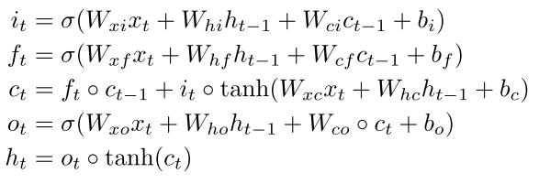
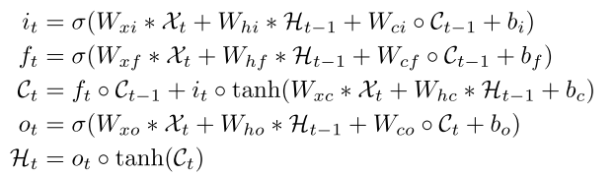
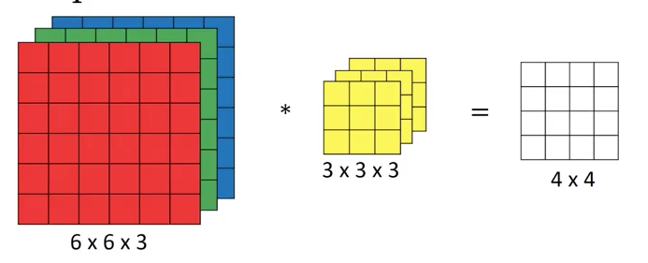
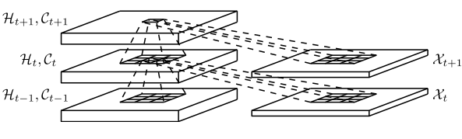
Convolutional-LSTM
LSTM -> Convolutional-LSTM
Extract temporal feature -> Extract spatiotemporal feature
Model equations are below.
->
LSTM
Convolutional LSTM
Input to State
State to State
r : row
c : column
f : feature
fn : number of filter
fw : filter width
fh : filter height
Input tensor
(r x c x f)
Input Filter
(fw x fh x f)
State to State
Input to State
State tensor
(r x c x fn)
State Filter
(fw x fh x fn)
Notes:
Then How to extract spatial data by using Convolutional-LSTM?
The key is difference between LSTM equation and Convolutional LSTM equation.
First One is : State parameter, gate and weight are 3D tensor, not 2D vector.
Second One is : use convolution operator on state to state and input to state transaction.
In this equation, blue box denote to convolution operation of state to state transaction.
W is filter and X is input tensor.
Green box denote to convolution operation of input to state transaction.
H is hidden state.
To explain more detail, This draw show dimension of input, state and filter .
The input and state filter slide on input and state tensor individually,
So the result extract spatial information and This is applied to next time state.

Slide 5
Model Example
Input : 4D tensor
(4 input-timestep, row, column, feature)
ConvLSTM 2D layer
- 2d kernel 3x3 , 32 of Filters.
- This layer is used to encoder.
Flatten & Repeat Layer
- Reshape output of ConvLSTM to 2D tensor, (2 output-timestep, (row x column x filter) )
LSTM Layer
200 hidden state.
This layer is used to decoder.
Fully-Connected Layer
This layer is used to get final result.
Output
- Next 2-h PM10 concentration of 91 stations
ConvLSTM Model
Input ( 4 x 27 x 26 x 6)
…
ConvLSTM 2D layer output : (27 x 26 x 32)
Flatten & Repeat Layer output : (2 x 22464)
LSTM Layer
output : (2 x 200)
Fully-Connected Layer output : (2 x 91)
Output
(2 x 91)
Notes:
And This is model that I used.
But to explain more easily, some parameter are changed.
In this case, I set input-timestep to 4 and output-timestep to 2.
ConvLSTM 2D layer is used to encoder. And kernal size is 3 and 32 of filter are used.
Flatten & Repeat Layer reshape output of ConvLSTM to 2D tensor.
This is because the output will be used on LSTM, so the output format must be matched to LSTM.
LSTM is used to decoder.

Slide 6
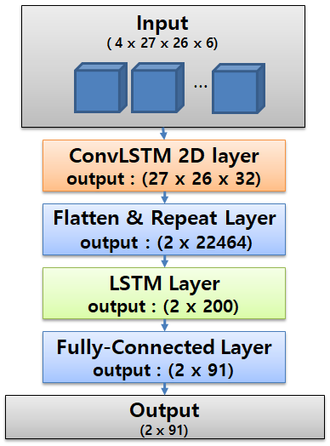
Data Flow
Encoded output 3D tensor
Past time (Encode)
(row
x column
x filter)
ConvLSTM
Cell
ConvLSTM
Cell x 32
ConvLSTM
Cell
ConvLSTM
Cell x 32
ConvLSTM
Cell
ConvLSTM
Cell
ConvLSTM
Cell x 32
ConvLSTM
Cell x 32
(row
x column
x feature)
t - 3
t - 2
t - 1
t
Notes:
So I’ll explain how dataset are processed by the model in detail.
Convolutional LSTM layer is used to Encoder.
This process past time data and output Encoded 3D tensor.
Input-timestep is set to 4,
So four 3d input tensors are used to input.
Blue arrows mean the inputs that enter each Cell.
Red arrows mean the output of cell that are state containing spatiotemporal feature of previous input, and this is sent to next cell.

Slide 7
Data Flow
1D vector x 2
(output timestep)
1D vector
((row
x column
x filter) x output timestep)
((row
x column
x filter))
Repeat
Flatten
ConvLSTM
Cell x 32
ConvLSTM
Cell x 32
ConvLSTM
Cell x 32
ConvLSTM
Cell x 32
t - 3
t - 2
t - 1
t
Notes:
On next,
Flatten and repeat layer are used to reshape the encoded 3d tensor.
This process is necessary because LSTM layer can not process 3D tensor that contain row and column.
So, the 3d tensor is converted to 2D tensor that contain just flatten encoded 3d tensor data and output timestep dimension.
왜 flatten + repeat layer가 필요한가.
다음 슬라이드에서 설명
And
multiplied

Slide 8
Data Flow
Future time (Decode)
t + 2
t + 1
1D vector (200)
LSTM
Cell x 200
LSTM
Cell x 200
Flatten & Repeat
ConvLSTM
Cell
ConvLSTM
Cell x 32
ConvLSTM
Cell
ConvLSTM
Cell x 32
ConvLSTM
Cell
ConvLSTM
Cell x
ConvLSTM
Cell x 32
ConvLSTM
Cell x 32
t - 3
t - 2
t - 1
t
Notes:
And LSTM layer is used to decode that predict next time series value.
Reshaped encoded data enter each LSTM Cell then the cell output 1D vector in each prediction time

Slide 9
Data Flow
t + 2
t + 1
1D vector (91)
= prediction value of 91 stations
Fully-Connected
Cell x 91
Fully-Connected
Cell x 91
LSTM
Cell x 200
LSTM
Cell x 200
Flatten & Repeat
ConvLSTM
Cell
ConvLSTM
Cell x 32
ConvLSTM
Cell
ConvLSTM
Cell x 32
ConvLSTM
Cell
ConvLSTM
Cell x
ConvLSTM
Cell x 32
ConvLSTM
Cell x 32
t - 3
t - 2
t - 1
t
Notes:
Finally,
Full-Connected Layer is used to get final prediction value of 91 PM stations.
-------------------------------------- It is because to increase model complexity
This is same to add some option on model to solve more complex problem.
This is basic method to develop performance.

Slide 11
Encoder-Decoder Structure
Y₁
Y₆
ConvLSTM Output Vector
ConvLSTM
Cell
ConvLSTM
Cell
Encoded
Output
Vector
…..
Decoder
Encoder
ConvLSTM
Cell
ConvLSTM
Cell
ConvLSTM
Cell
…..
X₁
X₂
…
X₂₄
Input Sequence
Notes:
And this is basic encoder-decoder structure that I used.
This structure is made to solve Sequence to Sequence problem.
Encoder encodes input-sequence continuously, and makes encoded output vector.
Decoder interprets this and generate output sequence.
In time series problem, Input Sequence is from past data.
So the size of Input Sequence is input-timestep
And Output Sequence is future data.
So The size of output Sequence is output-timestep
This mean that Input Sequence is from past data.
In this case, input time-step is 4 and output time-step is 2.

Slide 12
Encoder-Decoder Structure
Y_{6 …..}
Y₁
ConvLSTM Output Sequence
ConvLSTM
Cell
ConvLSTM
Cell
Encoded
Output
Vector
…..
Decoder
Encoder
ConvLSTM
Cell
ConvLSTM
Cell
ConvLSTM
Cell
…..
X₁
X₂
…
X₂₄
Input Sequence
Notes:
And this is basic encoder-decoder structure that I used.
This structure is made to solve Sequence to Sequence problem.
Encoder encodes input-sequence continuously, and makes encoded output vector.
Decoder interprets this and generate output sequence.
In time series problem, Input Sequence is from past data.
So the size of Input Sequence is input-timestep
And Output Sequence is future data.
So The size of output Sequence is output-timestep
This mean that Input Sequence is from past data.
In this case, input time-step is 4 and output time-step is 2.

Slide 13
Model Example
Region
Gyeonggi, Incheon, Seoul
Period
2014.1.1 1:00 – 2015.12.31 24:00 (Training Set) & 2016.1.1 1:00 – 2016.12.31 24:00 (Testing Set)
Input Parameters | Unit | Source | Model Input
Past 24-h PM10 concentration | ug/m³ | 53 of PM10 stations | Convolutional LSTM, CNN
Past 24-h Temperature | ℃ | 3 of methodological stations | CNN
Past 24-h Humid | % | 3 of methodological stations | CNN
Past 24-h Vapor Pressure | hPa | 3 of methodological stations | CNN
Past 24-h Wind speed | m/s | 3 of methodological stations | CNN
Past 24-h Wind sin component | m/s | 3 of methodological stations | Convolutional LSTM
Past 24-h Wind cos component | m/s | 3 of methodological stations | Convolutional LSTM
Output Parameters
Next 6-h PM10 concentration | ug/m³ | 53 of PM10 stations
Notes:
And This is model that I used.
But to explain more easily, some parameter are changed.
In this case, I set input-timestep to 4 and output-timestep to 2.
ConvLSTM 2D layer is used to encoder. And kernal size is 3 and 32 of filter are used.
Flatten & Repeat Layer reshape output of ConvLSTM to 2D tensor.
This is because the output will be used on LSTM, so the output format must be matched to LSTM.
LSTM is used to decoder.

Slide 14
ConvLSTM Model
CNN Model
Model Example
Input with PM and Wind ( 24 x 9 x 9 x 3)
Input without Wind -direction (24 x (53+3x5))
…
…
2D ConvLSTM Layer
output : (9 x 9 x 64)
Repeat output : (4 x 9 x 9 x 64)
1D CNN Layer output : (22 x 256)
2D ConvLSTM Layer output : (4 x 9 x 9 x 64)
1D CNN Layer output : (20 x 256)
Reshape output : (4 x (9 x 9 x 64))
Repeat output : (4 x (20 x 256))
Merge output : (4 x (9 x 9 x 64 + 20 x 256 ))
Fully-Connected Layer output : (4 x 500)
Fully-Connected Layer output : (4 x 500)
Next 4h Series Output of all PM stations
(4 x 53)
Notes:
And This is model that I used.
But to explain more easily, some parameter are changed.
In this case, I set input-timestep to 4 and output-timestep to 2.
ConvLSTM 2D layer is used to encoder. And kernal size is 3 and 32 of filter are used.
Flatten & Repeat Layer reshape output of ConvLSTM to 2D tensor.
This is because the output will be used on LSTM, so the output format must be matched to LSTM.
LSTM is used to decoder.

Slide 15
Model Example
ConvLSTM Model
Output
(2 x 91)
Notes:
And This is model that I used.
But to explain more easily, some parameter are changed.
In this case, I set input-timestep to 4 and output-timestep to 2.
ConvLSTM 2D layer is used to encoder. And kernal size is 3 and 32 of filter are used.
Flatten & Repeat Layer reshape output of ConvLSTM to 2D tensor.
This is because the output will be used on LSTM, so the output format must be matched to LSTM.
LSTM is used to decoder.

